Slide 1
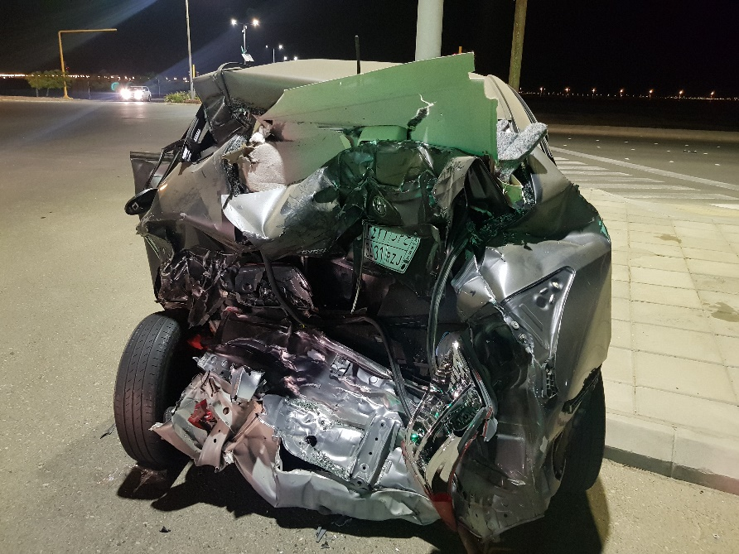
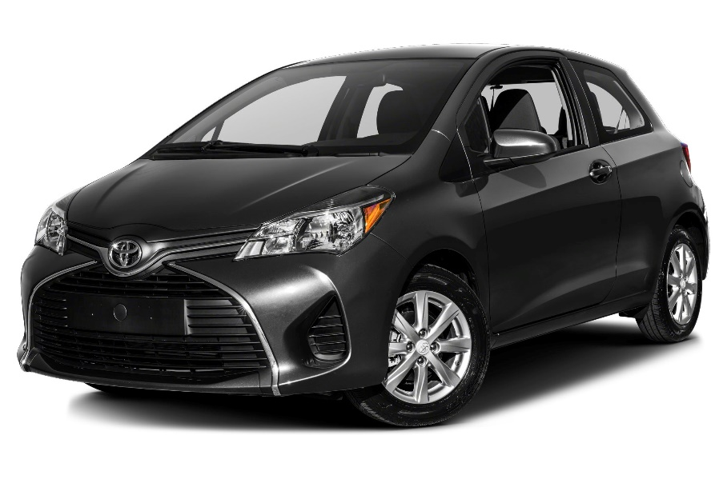


Imagine having cars that can repair themself without human intervention after accidents.

Slide 2
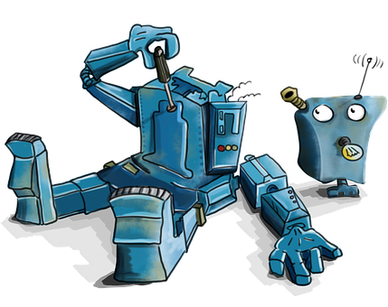
More in general, imagine all electronic devices could repair themself.

Slide 3
We want to address this dream. We start with a practical example.

Slide 4
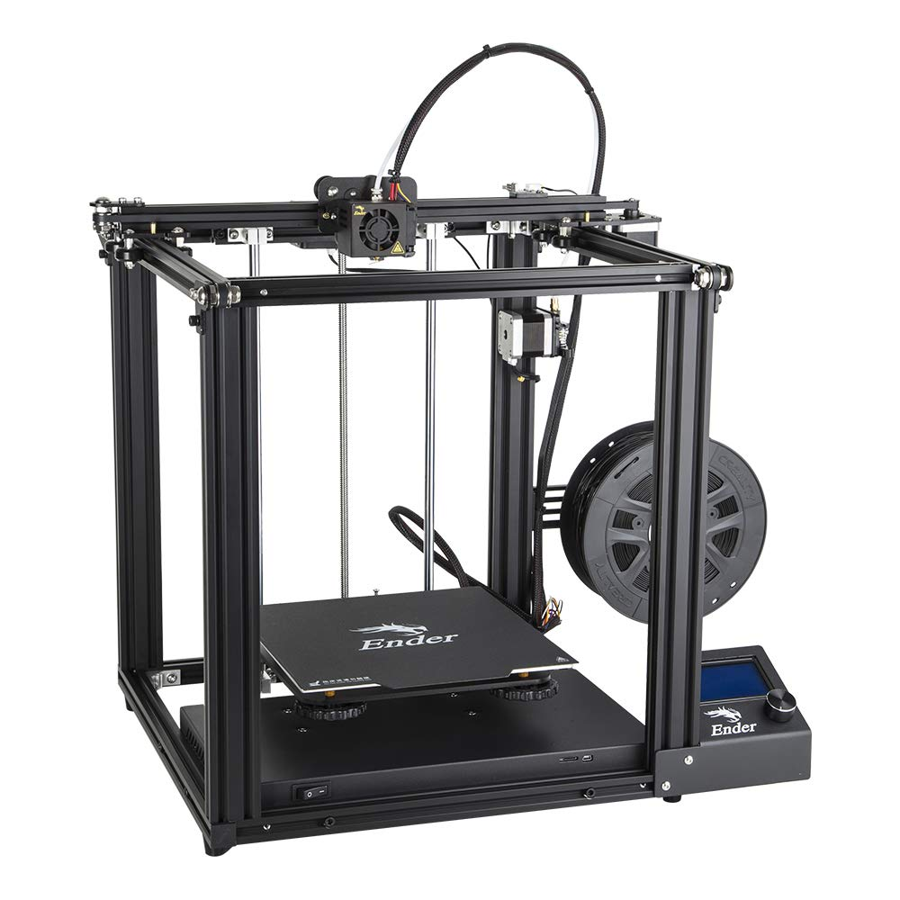
We want to evaluate a printer's capacity for repairing itself after one of its parts has been damaged.

Slide 5
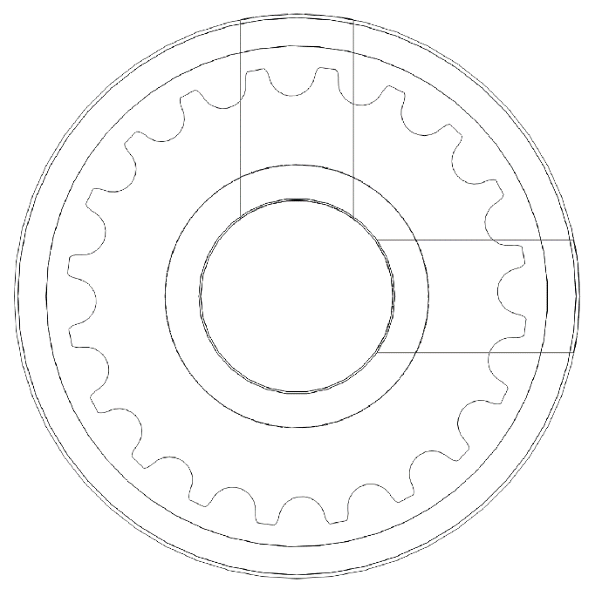
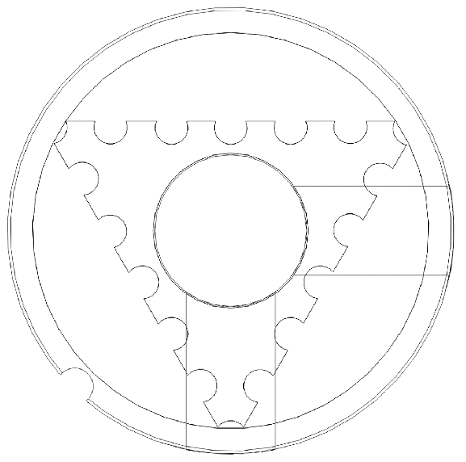
To simulate a broken part, we substitute a working pullet with a triangular one.

Slide 6
We simulate before to ensure that we will not force the timing belts.

Slide 7
Finally, we put the triangular pulley in the printer and try to print a cylindrical that will replace the triangular one.

Slide 8
As we said, we start with the triangular pulley.

Slide 9
As we try to print a cylinder one, we do not get exactly what we want.

Slide 10
However, if we substitute the newly printed pulley and try again, we converge to the desired pulley.

Slide 11
We are willing to apply this method to each printer's part and eventually other robots.

